Slide 1
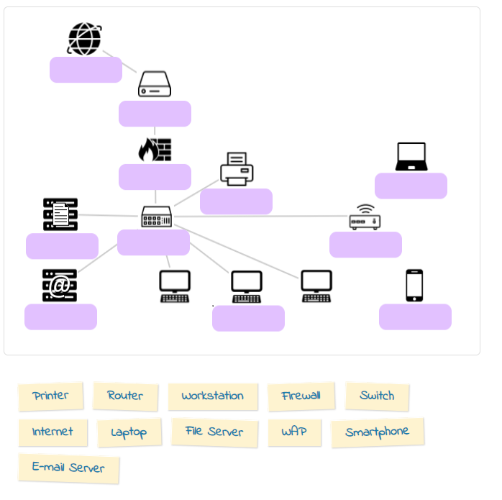
internet
router
Firewall
laptop
printer
File server
switch
wap
E-mail server
workstation
smartphone

